Slide 1
Legal Issues, Social Impact, and Professional Ethics in Software EngineerinG
COMP6100001 - Software engineering
Session 25
Kenny Jingga, S.Kom., M.T.

Slide 2
Session 25 – Legal Issues, Social Impact, and Professional Ethics in Software EngineerinG
Learning objectives
At the end of this session, students will be expected to be able:
Understand the legal aspects of software engineering.
Learn about intellectual property rights and licensing models.
Explore privacy laws, data protection, and compliance standards.
Recognize the social implications of software engineering.
Develop an understanding of professional ethics and ethical frameworks.
Apply ethical decision-making models to real-world scenarios.

Slide 3
Session 25 – Legal Issues, Social Impact, and Professional Ethics in Software EngineerinG
Content outline
Legal aspects in software engineering
Intellectual property & licensing
Privacy laws & compliance
Social impact of software
Professional ethics & codes of conduct
Ethical decision-making

Slide 4
Overview of Legal Aspects in Software Engineering
Legal Considerations in Software Development
Legal Considerations:
Software engineers must consider legal constraints throughout the development process to avoid violations and protect both users and the company.
Legal aspects often overlap with issues of intellectual property, data security, and compliance.
Relevance in Software Development:
Compliance with laws prevents potential lawsuits, financial loss, and reputational damage.

Slide 5
Intellectual Property Rights
Copyrights, Patents, Trademarks
Copyrights: Protects the software code and documentation as original works.
  Example: Source code is protected, making unauthorized copying or distribution illegal.
Patents: Protects new, non-obvious inventions and unique processes in software.
  Example: Google’s patent on their page-ranking algorithm.
Trademarks: Protects names, symbols, or logos associated with software or services.
  Example: Microsoft’s trademark of the Windows logo.
Importance:
  Intellectual property rights encourage innovation by allowing creators to benefit from their inventions while protecting against misuse.

Slide 6
Licensing Models for Software
Software Licenses
Types of Software Licenses:
  Proprietary Licenses: Restrict users from modifying, sharing, or redistributing the software.
  Open Source Licenses: Allow users to access, modify, and share the source code (e.g., MIT, GPL).
  Freeware and Shareware: Software distributed for free or for a limited trial period before payment.
Licensing Importance:
  Defines how software can be used, distributed, and modified, impacting how developers can engage with the software.

Slide 7
Privacy Laws and Data Protection
GDPR and CCPA
General Data Protection Regulation (GDPR):
  European regulation focusing on user data privacy and security, including the right to be forgotten and consent requirements.
California Consumer Privacy Act (CCPA):
  Regulates data collection and sharing practices, especially for companies handling personal data of California residents.
Key Principles of Privacy Laws:
  Data Minimization: Only necessary data should be collected.
  Purpose Limitation: Data collected should only be used for specified purposes.
  Data Security: Ensuring data protection from breaches and misuse.

Slide 8
Software Compliance and Regulatory Standards
Overview of Compliance Standards:
  Standards like ISO 27001 for security management and PCI-DSS for payment security.
Why Compliance Matters:
  Compliance demonstrates a commitment to safety and security, reducing the risk of legal penalties and enhancing trust.
Example: E-commerce sites comply with PCI-DSS standards to securely handle credit card information.

Slide 9
Social Implications of Software Engineering
The Positive and Negative impacts
Positive Impacts:
  Innovation in software provides benefits like improved communication, access to information, and automation of tasks.
Negative Impacts:
  Issues such as job displacement, digital divide, and privacy concerns arise with rapid technological advancement.
Example: Social media platforms impact communication but also raise issues of privacy and mental health.

Slide 10
Case Studies on Legal Issues and Social Impact in Software
Case Study 1: Cambridge Analytica
  Discuss the misuse of Facebook data and the impact on user privacy and trust.
Case Study 2: Microsoft and Open Source
  Explore Microsoft’s shift to support open-source software and the legal and social implications of this move.
Discussion:
  Analyze the lessons learned from each case in terms of legal compliance, social responsibility, and ethical practices.

Slide 11
Understanding Professional Ethics
What is Human Flourishing?
According to Harvard’s Human flourishing program:
Human flourishing is composed of five central domains: happiness and life satisfaction, mental and physical health, meaning and purpose, character and virtue, and close social relationships.

Slide 12
Understanding Professional Ethics
Why Human Flourishing?
Universal Declaration of Human Rights: “All human beings are born free and equal in dignity and rights.”
Declaration of Independence: “We hold these truths to be self- evident...”
Internal Compass
Faith

Slide 13
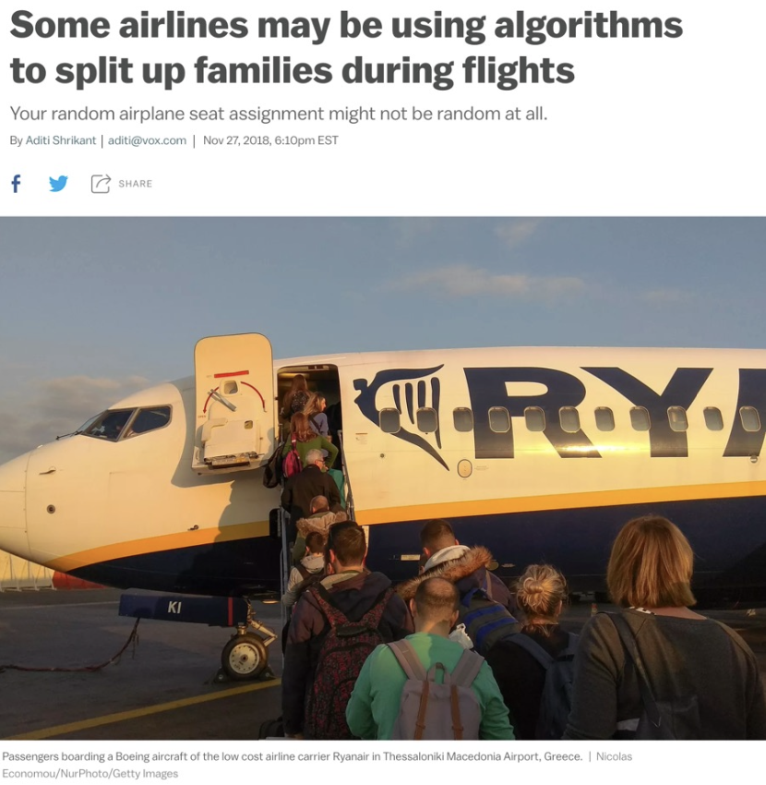
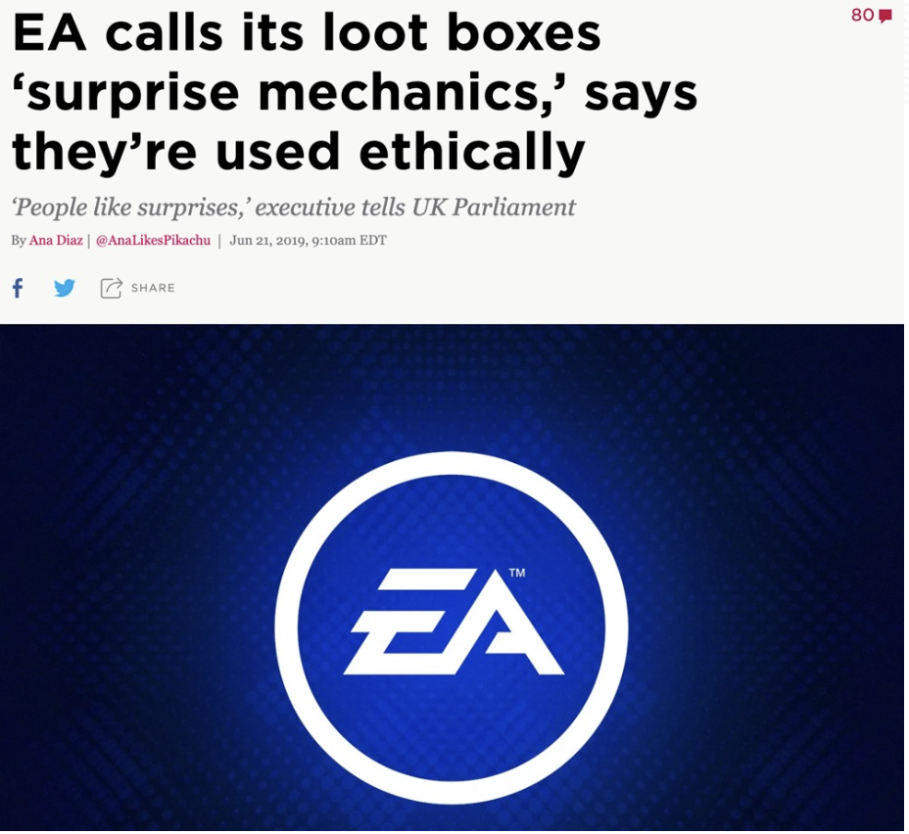
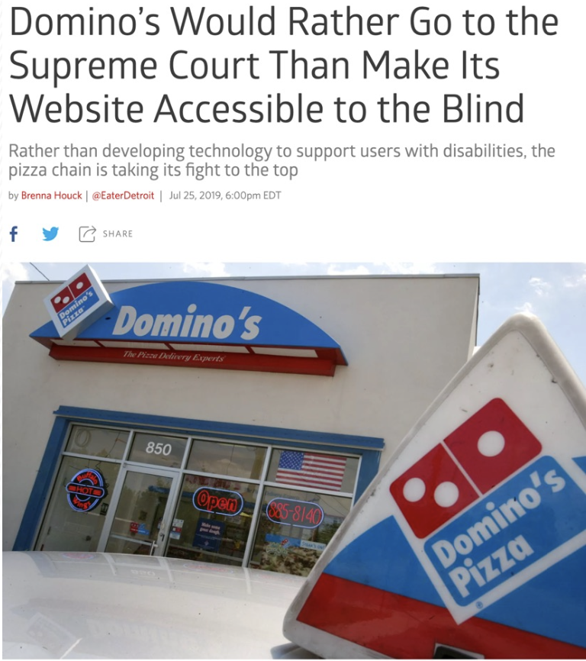
Understanding Professional Ethics
(UN)Ethical Situations

Slide 14
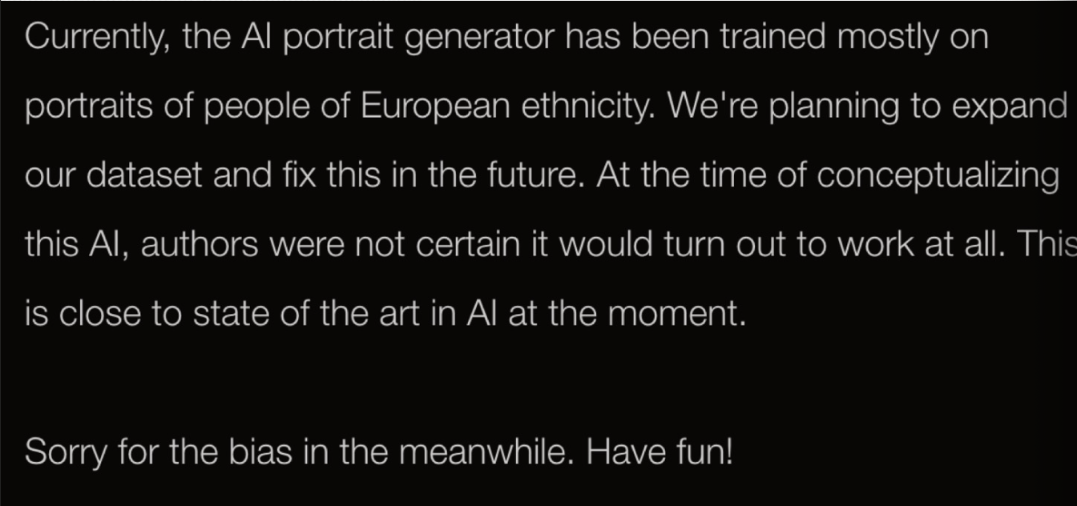
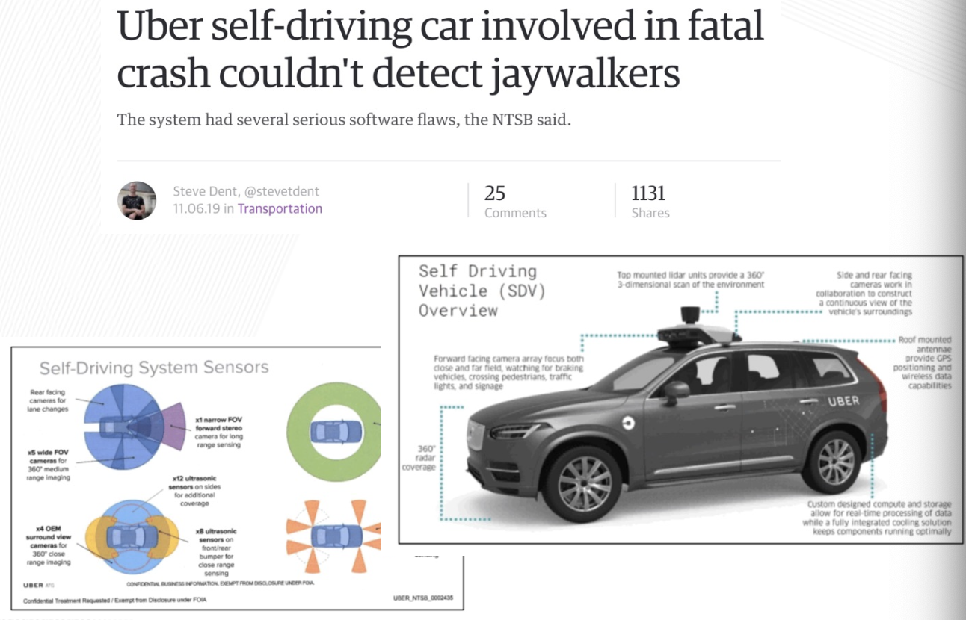
Understanding Professional Ethics
(UN)Ethical Situations

Slide 15
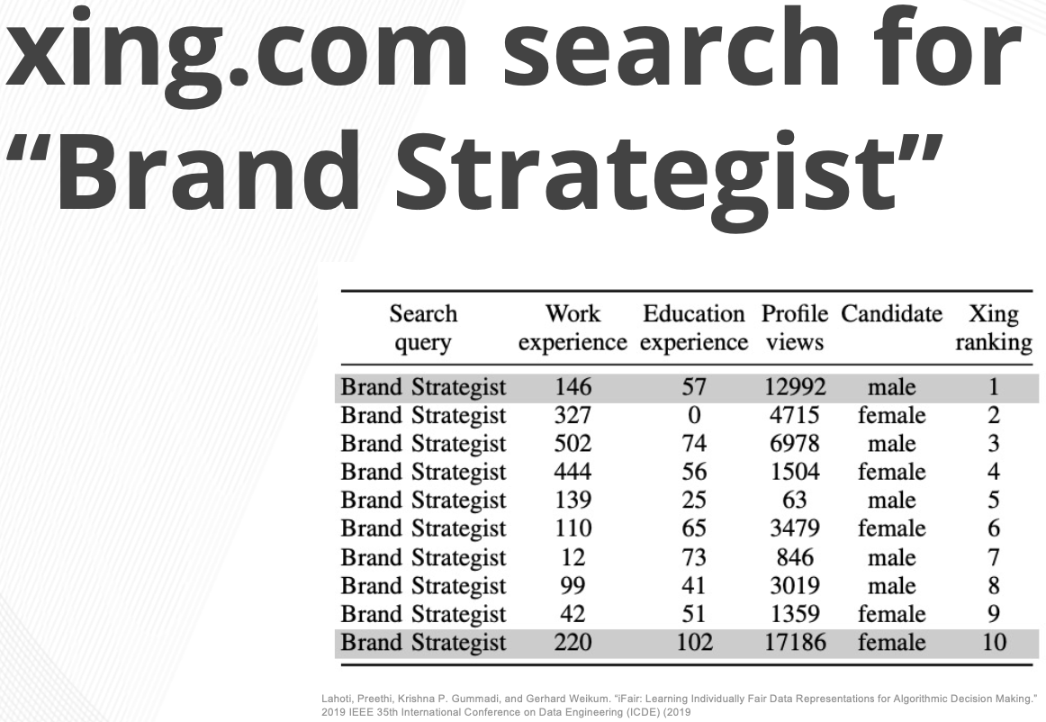
Understanding Professional Ethics
(UN)Ethical Situations

Slide 16
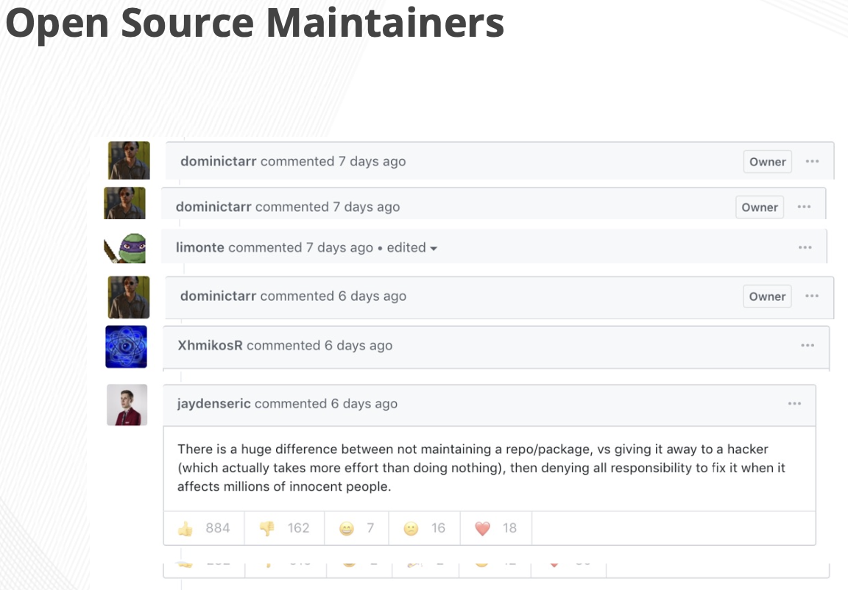
Understanding Professional Ethics
(UN)Ethical Situations

Slide 17
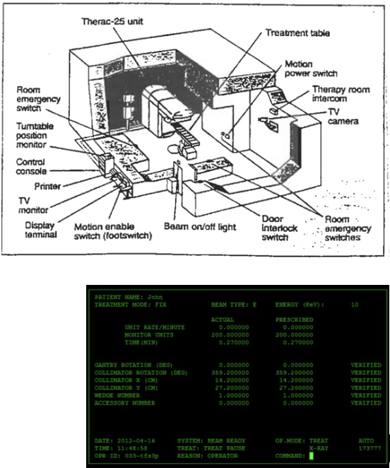
Understanding Professional Ethics
Therac-25
Bug (race-condition) in software lead to at least 6 deaths
Traced to:
  Lack of reporting bugs
  Lack of proper due diligence
  Engineers were overconfident, removed hardware locks
  Race condition of 8 seconds could lead to problems

Slide 18
Understanding Professional Ethics
Definition and importance
Ethics refers to a set of moral principles guiding professional behavior and decisions in software engineering.
Ethical practices help protect users, enhance trust, and contribute to a positive societal impact.

Slide 19

Code of Ethics for Software Engineers
Code of Ethics: ACM
As an ACM member I will ....
Contribute to society and human well-being. Avoid harm to others.
Be honest and trustworthy.
Be fair and take action not to discriminate.
Honor property rights including copyrights and patent.
Give proper credit for intellectual property.
Respect the privacy of others. Honor confidentiality.

Slide 20
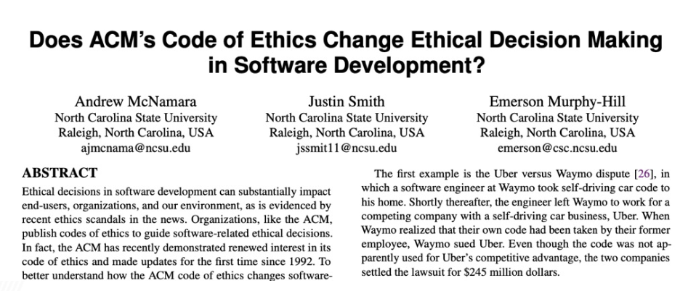
Code of Ethics for Software Engineers
Code of Ethics: ACM
Research shows that the code of ethics does not appear to affect the decisions made by software developers.

Slide 21
Ethical Responsibilities of Software Professionals
Challenge
How do we apply ethics to a field (Software Engineering) that is changes so often?
Remember the Dominos case? The ADA law was written before the first website (1990)
To handle this uncertainty about the future, let’s focus on three questions we can ask to remind ourselves to focus on promoting human flourishing.

Slide 22
Ethical Responsibilities of Software Professionals
Responsibilities to Users and Society
Responsibilities to Users:
Ensure software safety, security, and accessibility.
Responsibilities to Society:
Consider the broader societal impact, such as environmental effects and social welfare.

Slide 23
Ethical Responsibilities of Software Professionals
Three questions to promote human flourishing
Does my software respect the humanity of the users?
Does my software amplify positive behavior, or negative behavior for users and society at large?
Will my software’s quality impact the humanity of others?
These questions are the start of the conversation, but as technology evolves, we must be vigilant to ensure we are promoting human flourishing

Slide 24
Ethical Decision-making Models
Steps in ethical decision-making
Identify the issue
Gather information
Consider the impact on stakeholders
Explore alternatives, and
Make a decision based on ethical principles.
Example: Model applied to decide if certain data collection practices are ethical.

Slide 25
Addressing Ethical Dilemmas in the Workplace
Handling Dilemmas
Techniques for resolving ethical dilemmas, such as seeking advice from mentors or following organizational guidelines.
Example: Handling an ethical conflict between project deadlines and thorough security testing.

Slide 26
Promoting Ethical Practices in Software Teams
Creating an ethical culture
Encouraging open discussion of ethics, setting up channels for reporting ethical concerns, and recognizing ethical conduct.
Example: Implementing peer review processes that include ethical considerations.

Slide 27
References
Titus Winters, Tom Manshreck, and Hyrum Wright. (2020). Software Engineering at Google: Lesson Learned from Programming Over Time. 1st. O’Reilly Media. California. ISBN: 978-1492082798.
Roger Pressman and Bruce Maxim. (2020). Software Engineering: A Practitioner's Approach. 9th. McGraw Hill. New York. ISBN: 978-1259872976.
Ian Sommerville. (2016). Software Engineering. 10th. Pearson. London. ISBN: 978-1-292-09613-1.

